Slide 1

COURSE: DATA SCIENCE tOPIC: Statistics INSTRUCTOR: REEMA MEMON

Slide 2
Overview:
The probability of an event is a value between 0 and 1 inclusive. It indicates how likely the occurrence of this event is.
A value of 0 means this event is not likely to occur. On the other hand, a value of 1 means this event is sure to happen. Any value in between indicates likelihood.
The larger the value, the more the possibility.
Now, let’s consider two events, A and B. Joint, marginal, and conditional probabilities are values we obtain by considering both events A and B.

Slide 3
Probability of an Event:
Let’s assume that we’ll perform a well-known experiment. If we’re accurate and get all the ingredients right, then we already know the outcome. Such experiments are called deterministic. On the other hand, some experiments are not as predictable. We call them random.

Slide 4
What is an Event?
An event is a set of outcomes of a random experiment. It is thus a subset (part) of the sample space. Using the experiment of the weather station, let’s define three events:
Probabilities of Events:
P(A)=Favorable Outcomes/Total Number of Outcomes
P(A)`= 1-P(A)
P(A)` is the inverse of P(A).

Slide 5
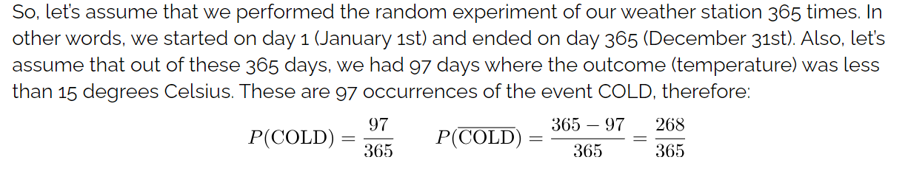

Slide 6
Joint Probability:
Let A and B be the two events, joint probability is the probability of event B occurring at the same time that event A occurs.
Formula for Joint Probability
Notation to represent the joint probability can take a few different forms. The following formula represents the joint probability of events with intersection.
P (A⋂B)
where,
A, B= Two events
P(A and B), P(AB)=The joint probability of A and B
The symbol “∩” in a joint probability is called an intersection. The probability of event A and event B happening is the same thing as the point where A and B intersect. Hence, the joint probability is also called the intersection of two or more events. We can represent this relation using a Venn diagram as shown below.

Slide 7
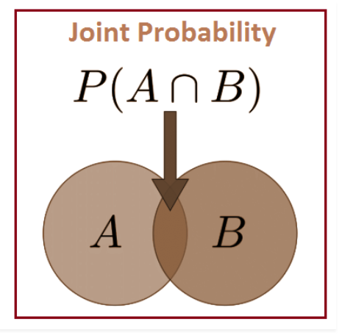

Slide 8
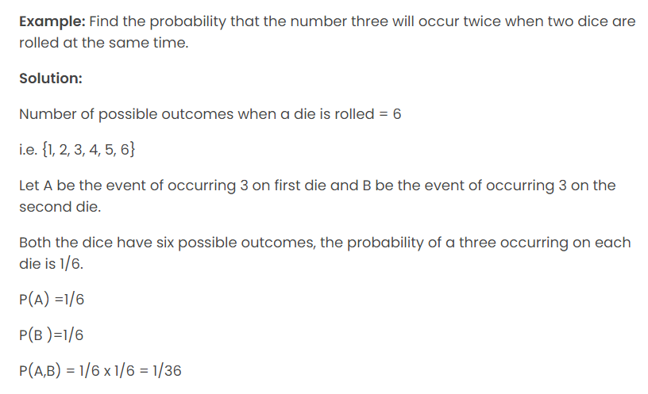
Joint Probability Example:

Slide 9
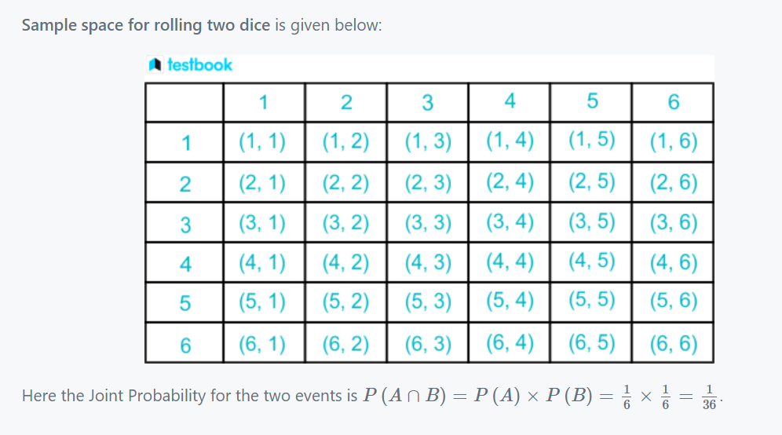

Slide 10
Question:
Suppose you have a deck of cards and you draw two cards without replacement. What is the probability of drawing a red card and then drawing a queen? Let's assume the deck contains 52 cards with 26 red cards and 4 queens. Find the joint probability of drawing a red card and then drawing a queen.
Solution:
P(Red and Queen) = P(Red) * P(Queen | Red) = (26/52) * (4/51) = 1/52

Slide 11
Solution: P(Red and Blue) = P(Red) * P(Blue | Red) = (5/12) * (7/11) = 35/132
Question 2: Consider a bag containing 5 red balls and 7 blue balls. You randomly draw two balls from the bag, without replacement. What is the probability of drawing a red ball on the first draw and a blue ball on the second draw?

Slide 12
Marginal Probability:
The probability of an event occurring (p(A)), it may be thought of as an unconditional probability. It is not conditioned on another event.
Example: The probability that a card drawn is red (p(red) = 0.5).
Another example: The probability that a dice rolled is a four (p(four)=(1/6)).

Slide 13
Solution: The marginal probability can be calculated by dividing the number of red balls by the total number of balls in the bag. In this case, it is 10/(10+15) = 10/25 = 2/5.
Question 1:
Consider a bag containing 10 red balls and 15 blue balls. You randomly select a ball from the bag. What is the marginal probability of selecting a red ball?

Slide 14
Conditional probability:
It is known as the possibility of an event or outcome happening, based on the existence of a previous event or outcome.
Imagine a student who takes leave from school twice a week, excluding Sunday. If it is known that he will be absent from school on Tuesday then what are the chances that he will also take a leave on Saturday in the same week? It is observed that in problems where the occurrence of one event affects the happening of the following event, these cases of probability are known as conditional probability.

Slide 15
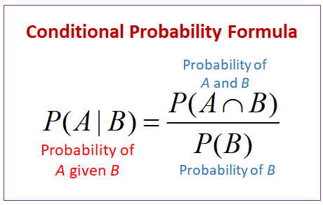

The probability of occurrence of any event A when another event B in relation to A has already occurred is known as conditional probability.
Conditional Probability Formula:

Slide 16
Question:
The probability of a student passing in science is ⅘ and the of the student passing in both science and maths is ½. What is the probability of that student passing in maths knowing that he passed in science?
Solution:
Let A ≡ Event of passing in science
B ≡ Event of passing in Maths
Given, P(B) = ⅘ and P(A ∩ B) = ½
Then, probability of passing maths after passing in science =
P(B|A) = P(A ∩ B)/P(A)
= ½ ÷ ⅘ = ⅝
∴ the probability of passing in Maths is ⅝.

Slide 17
Question 1:
In a survey among few people, 6/10 probability of people read Urdu newspaper, 4/10 probability of people read English newspaper and 2/10 read both. If a person is chosen at random and if he already reads English newspaper find the probability that he also reads Urdu newspaper.
Question 2:
A fair coin is tossed twice such that E: event of having both head and tail, and F: event of having at most one tail. Find P(E), P(F) and P(E|F)

Slide 18
Solution 1:
Let there be 100 people in the survey, then
Number of people read Urdu newspaper = n(A) = 60
Number of people read English newspaper = n(B) = 40
Number of people read both = n(A ∩ B) = 20
Probability of the person reading Urdu newspaper when he already reads English newspaper is given by –
P(A|B) = n(A ∩ B)/n(B) = 20/40 = ½.

Slide 19
Solution 2:
The sample space S = { HH, HT, TH, TT}
E = {HT, TH}
F = {HH, HT, TH}
E ∩ F = {HT, TH}
P(E) = 2/4 = ½
P(F) = ¾
P(E ∩ F) = 2/4 = ½
P(E|F) = P(E ∩ F)/P(F) = ½ ÷ ¾ = ⅔.

Slide 20
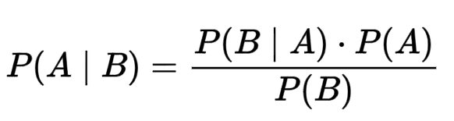
Now, there is another way to calculate the conditional probability.
Specifically, one conditional probability can be calculated using the other conditional probability. Such a case is known as Bayesian Probability or Bayesian Theorem.
The formula for Bayes’ Theorem is:
The reverse is also true.

Slide 21
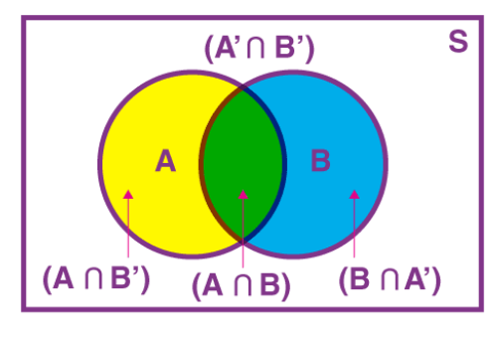
Law of Total Probability:
The Law of Total Probability is a fundamental concept in probability theory. It states that the probability of an event can be expressed as the sum of the probabilities of that event occurring under different conditions or scenarios.
For two events A and B associated with a sample space S, the sample space can be divided into a set A ∩ B′, A ∩ B, A′ ∩ B, A′ ∩ B′.

Slide 22

Law of Total Probability (LOTP):
Question:
A person has undertaken a mining job. The probabilities of completion of the job on time with and without rain are 0.42 and 0.90 respectively. If the probability that it will rain is 0.45, then determine the probability that the mining job will be completed on time.
Solution:
Let A be the event that the mining job will be completed on time and B be the event that it rains. We have,
P(B) = 0.45,
P(no rain) = P(B′) = 1 − P(B) = 1 − 0.45 = 0.55

Slide 23
By multiplication law of probability,
P(A|B) = 0.42
P(A|B′) = 0.90
Since, events B and B′ form partitions of the sample space S, by total probability theorem, we have
P(A) = P(B) P(A|B) + P(B′) P(A|B′)
=0.45 × 0.42 + 0.55 × 0.9
= 0.189 + 0.495 = 0.684
So, the probability that the job will be completed on time is 0.684.

Slide 24
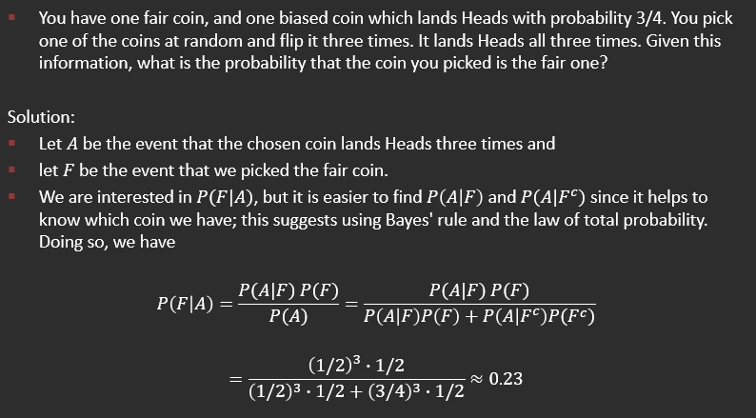
Example 2:

Slide 25
Example 3:
Suppose you have two boxes of cookies, Box A and Box B. Box A contains 8 chocolate chip cookies and 2 strawberry cookies, while Box B contains 4 chocolate chip cookies and 6 strawberry cookies. You randomly select one box and then randomly pick a cookie from that box. The cookie you picked is a chocolate chip cookie. What is the probability that you picked it from Box A?
Let's denote the events as follows: A: Picking from Box A. B: Picking a chocolate chip cookie.
Using Bayes' theorem, we can calculate the probability of picking from Box A given that the cookie is a chocolate chip cookie:
P(A | B) = (P(B | A) * P(A)) / P(B)
P(B | A) is the likelihood of picking a chocolate chip cookie given that you picked from Box A, which is 8/10 or 0.8.
P(A) is the prior probability of picking from Box A, which is 1/2 or 0.5 since there are two boxes and you randomly selected one.
P(B) is the probability of picking a chocolate chip cookie, which can be calculated as the sum of the probabilities of picking a chocolate chip cookie from each box.

Slide 26
P(B) = (P(B | A) * P(A)) + (P(B |A`) * P(A`)) = (0.8 * 0.5) + (0.4 * 0.5)
Now, we can substitute the values into Bayes' theorem:
P(A | B) = (0.8 * 0.5) / [(0.8 * 0.5) + (0.4 * 0.5)]

